Slide 1
Starting at 12:05!
Enjoy the music until then! Please turn on your camera and say hello in the chat!

Slide 2
Tutorial 07
COVID-19 Data Relief Project

Slide 3
So far...
We’ve covered how an API is used (Request-Response Cucel)
How to properly send and receive data (HTTP and JSON protocols)
Now we need to talk about authentication and identities

Slide 4
Authentication
When you log into a website, you use your username and password to tell the website who you are.
This process is known as authentication.
Similarly, API’s use several techniques to authenticate or identify a client (and their associated accounts/permissions)
These techniques are called authentication schemes

Slide 5
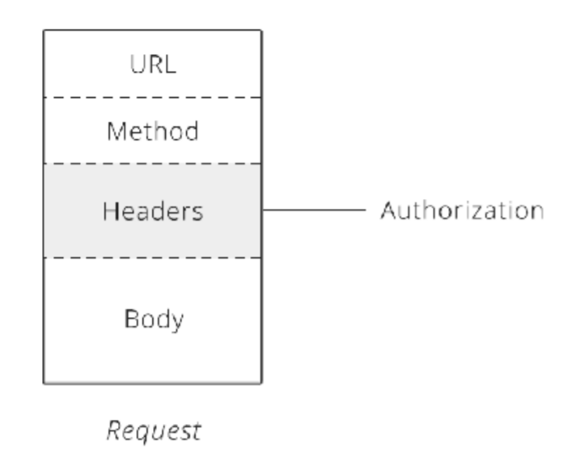
Basic Authentication
Official Term/Name
Similar to logging in, it requires a username and password
THe client combines these two credentials and passes them to the API via an HTTP header called Authorization
To review, lets look at the structure of a request
We will look at code in the next slide

Slide 6
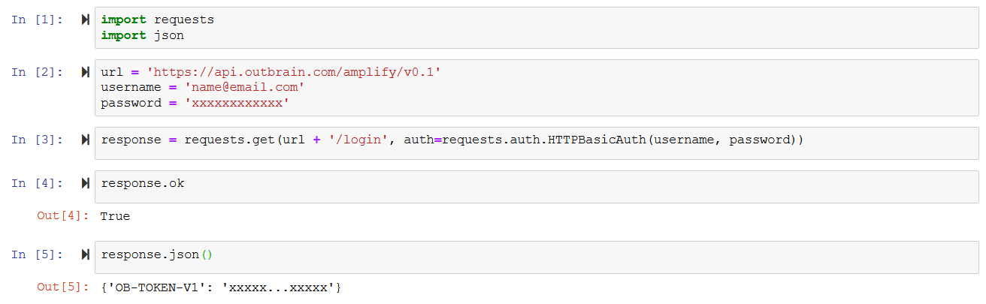
Basic Authentication Example

Slide 7
Benefits and Drawbacks
Simple and easy to use
However, using the same username and password to access the API and to manage your account is not ideal
For example, say you want to communicate with Google. Using your login info each time you request, say your schedule, can be dangerous, especially if you publish it onto the web.
Perhaps the client should have different permissions than the account owner
What if yu hire someone to work using your API
Giving them access to the master (your) account doesn;t seem ideal.
Thus, we will explore a commonly used alternative...

Slide 8
API Key Authentication
Instead of giving everyone access to the master account/sharing the same credentials, we instead use an API Key
An API Key is nothing more than a long series of letters and numbers - it has no meaning to humans.
To a server, it lets the server know to allow the the client access to the daa, but to limit permissions. For example, a Google API Key can allow you to access your emails (data) but will restrict you from deleting them (permissions).
Analogy: a hotel manager giving out guest passes - you can stay in the hotel (data) but you can’t change the layout of the hotel (permissions)

Slide 9
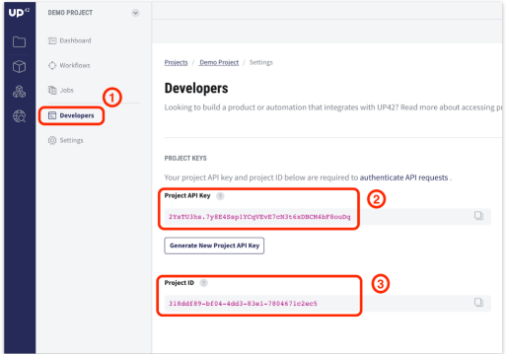
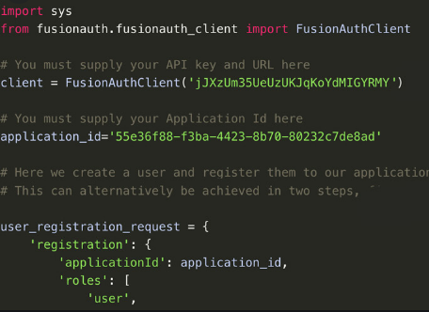
Code Example?
Not standardized, refer to individual API Documentation
If you have multiple project, you will need a corresponding projectId
Notes:
ProjectId → username

Slide 10
When life gives you lemons….
Okay, but all of this seems to arbirtly complex
What if we make a typo?
Accidentally publish it?
Automation concerns?

Slide 11
….make OAuth!
OAuth is a way to make our lives easier with an automated way to enter credentials
The server and client will send off a lot of requesta nd vreify the transaction, but for us, it will be relatively simple
Two versions: OAuth 1 and 2
One of the rare examples of thiings being named properly

Slide 12
OAuth 2
To review:
User: a developer who wants to connect two websites/services
Client: the website/service making the request
Server: the website/service that has the data
An analogy
I want to connect Slack and Google Calendar. Who;s hwo?

Slide 13
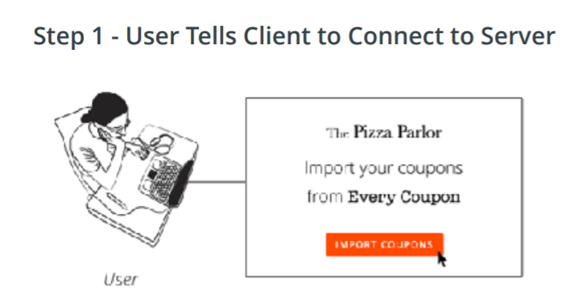
Step 1 - Connection
You tell Slack to connect to Google.

Slide 14
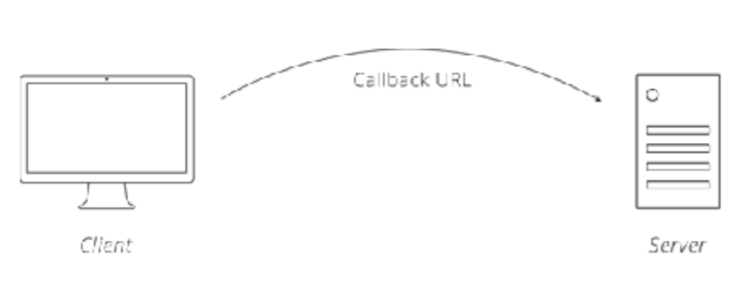
Step 2 - Redirection
The client sends the user to the server website, along with a callback URL
Basically, a landing page when you've finished with the server
Have you used a service where you logged in with Google? Same thing!

Slide 15
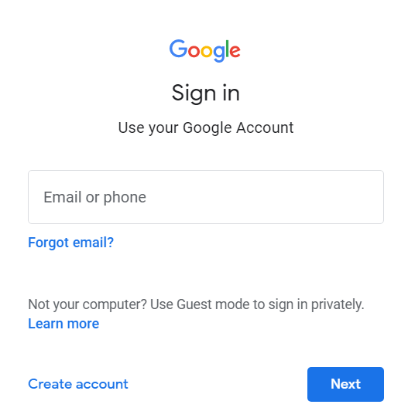
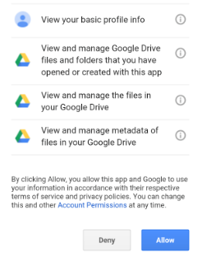
Step 3 - User Login and Permissions

Slide 16
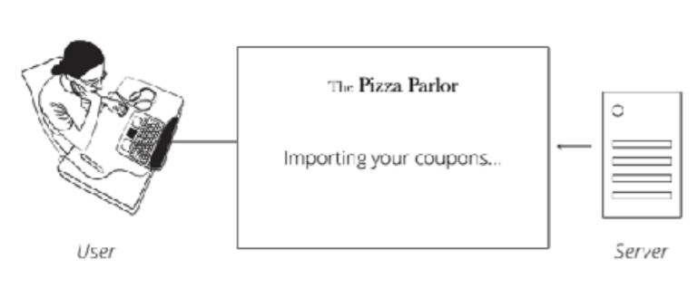
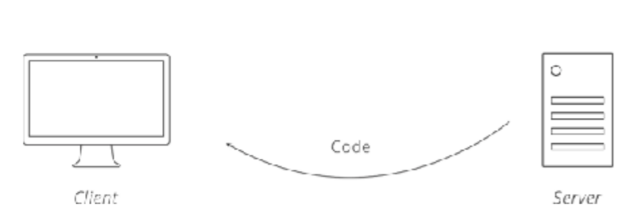
Step 4 - Server Sends Back User and Sends Client Code
User goes back to Slack and Slack receives some code from Google. This is some hidden authorization key.

Slide 17
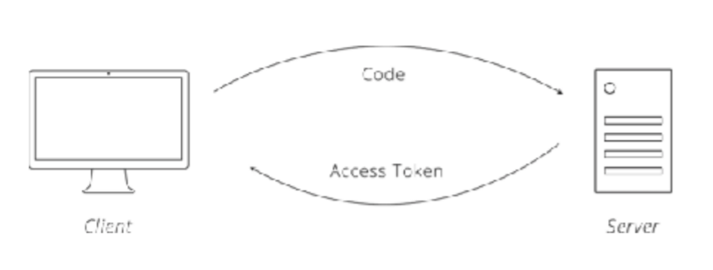
Step 5 - Client Exchanges Code + Secret Key For Access Token
Now, the client makes another request to the server, using the autorizaion key it received and a secret key. The server will verify this and send back an Access Token, or a code to know it has authenticated the client.

Slide 18
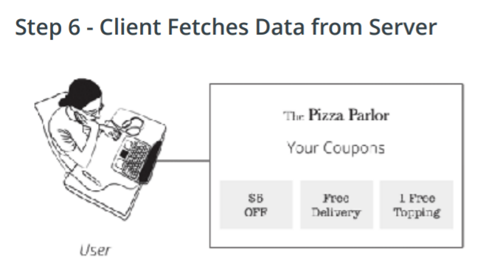
Step 6 - Lemonade!
We use the access token with every request we make so that the server knows we have been authenticated.

Slide 19
Optional
You may have thought it was kind of dangerous to have those access tokens - can't anyone just use them without going through the entire process?
To prevent this, we can optionally refresh the access token, o which the lifespan is set by server
Once the token expires, we repeat the process
If you had to sign into Zoom a lot, this is the reason why!
OAuth is very similar but with some key differences. This isn't as commonly used so we won't cover them here.

Slide 20
Final Note
Seems complex, but it really isn’t!
We don’t have to worry about the back-end, all we need to do is sign in and the computers will handle the rest.
Still, as devlopers, it is good for us to know these things if they ever come up

Slide 21
Next Time
Coding workshop - be prepared to ask questions. Open to literally anything!
Come in with whatever questions you have and we will answer them.
We will also discuss using API’s as well.
Future
Buffing up your resume!
Sharing socials
Capstone project to create your portfolio!

